Slide 1
Agenda Item 5.1 – S-100 Interoperability Specification
S100 Working Group

Slide 2
S-100 Interoperability Specification
New Name – Same objective
S-98 Specification for Data Product Interoperability in S-100 Navigation Systems
Specification No. | Title
S-101 | Electronic Navigational Chart (ENC) / Cartes électroniques de navigation
S-102 | Bathymetric Surface / Surface bathymétrique
S-104 | Water Level Information for Surface Navigation / Information de hauteur d’eau pour la navigation de surface
S-111 | Surface currents / Courants de surface
S-122 | Marine Protected Areas / Aires marines protégées
S-124 | Navigational warnings / Avertissements de navigation
S-411 | Sea Ice (WMO-IOC Joint Technical Commission for Oceanography and Marine Meteorology [JCOMM]) Glace de mer (Commission technique mixte OMM-COI pour l’océanographie et la météorologie marine [JCOMM])
S-412 | Met-ocean forecasts (JCOMM) Prévisions météo-océanographiques (JCOMM)

Slide 3
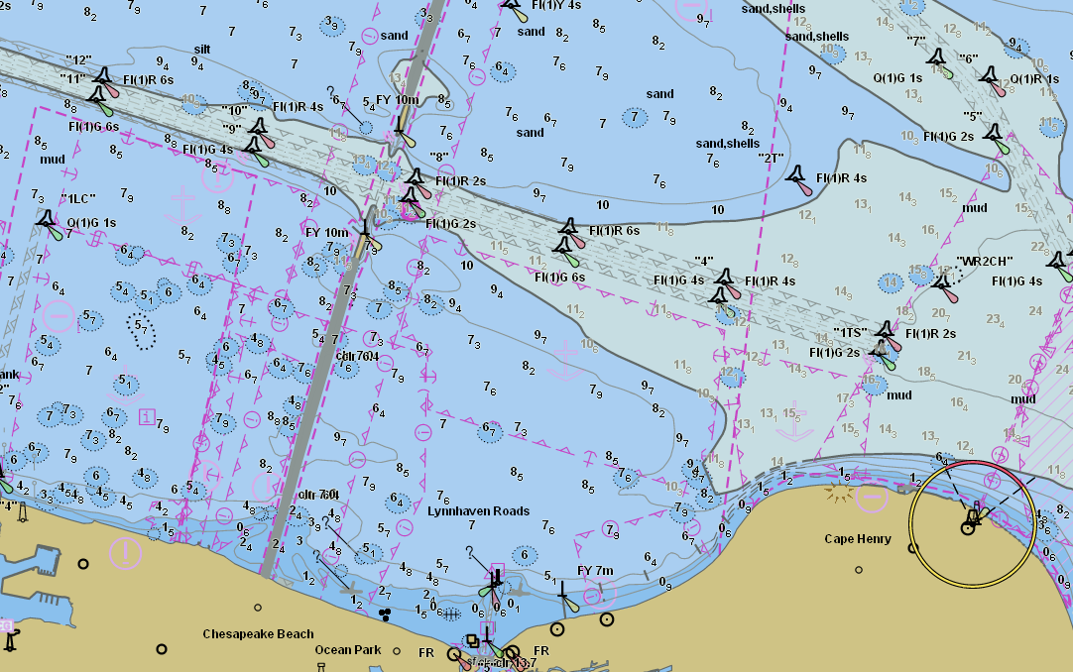

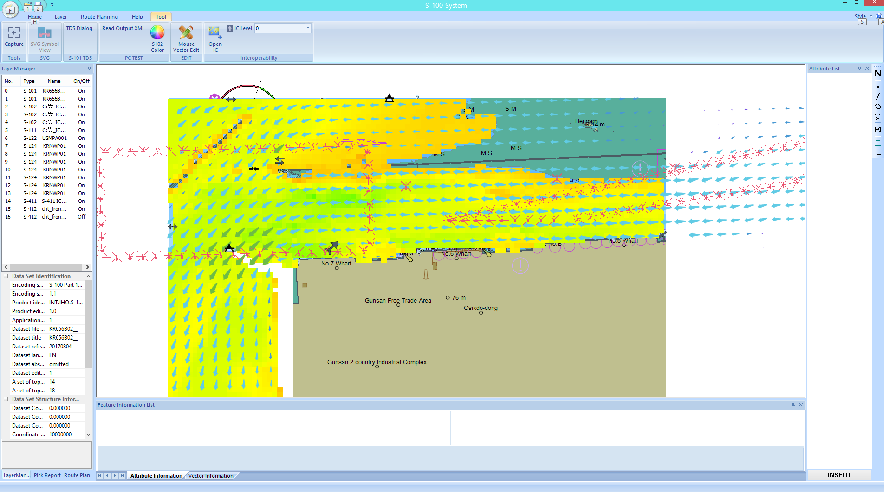
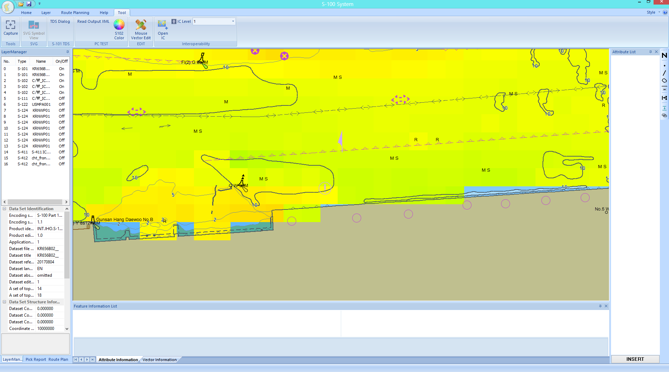


BAD Interoperability

Slide 4
Improved Interoperability
Takes into account how specifications relate to each other
Interleaving of features between products
Harmonizes Portrayal between products

Slide 5
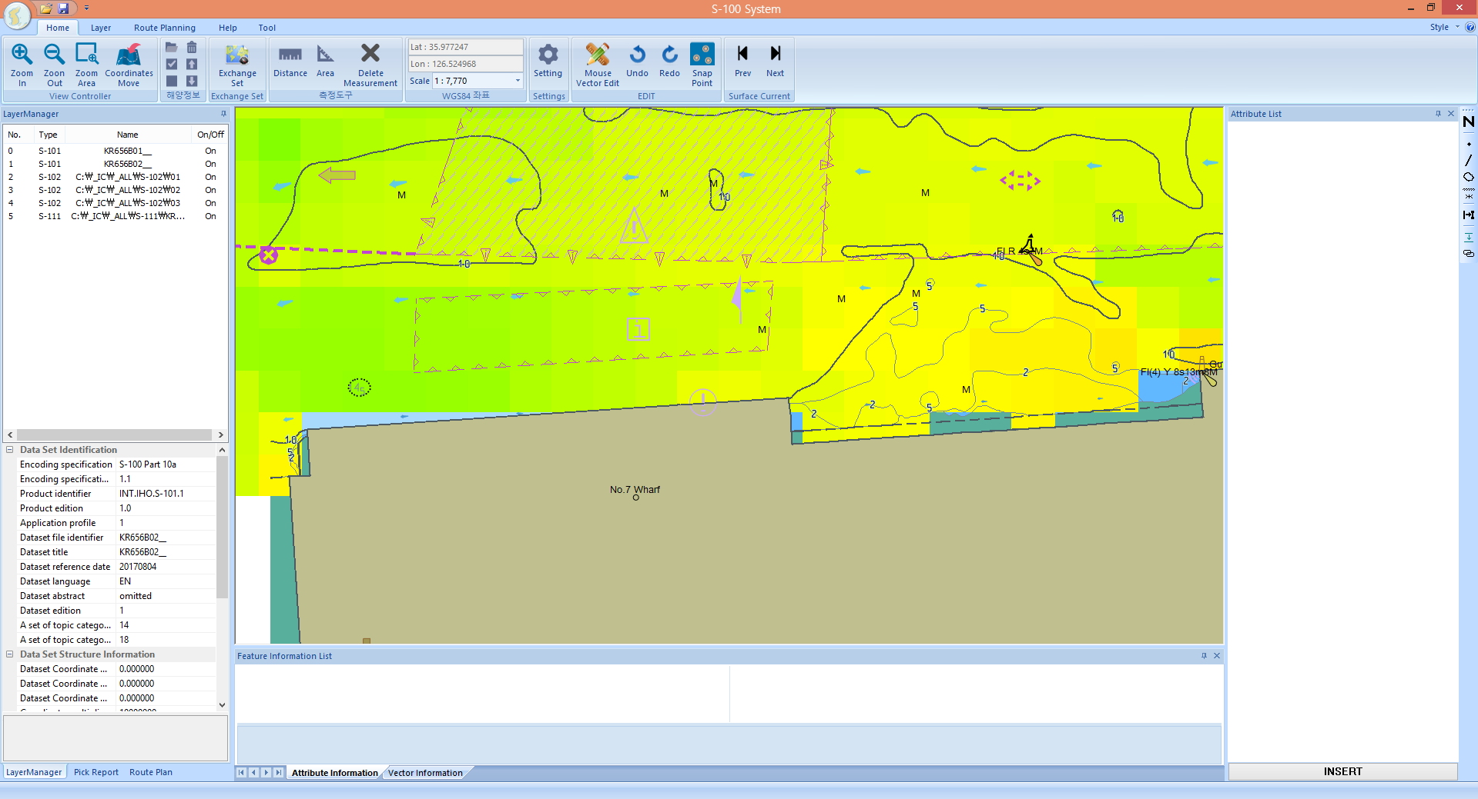
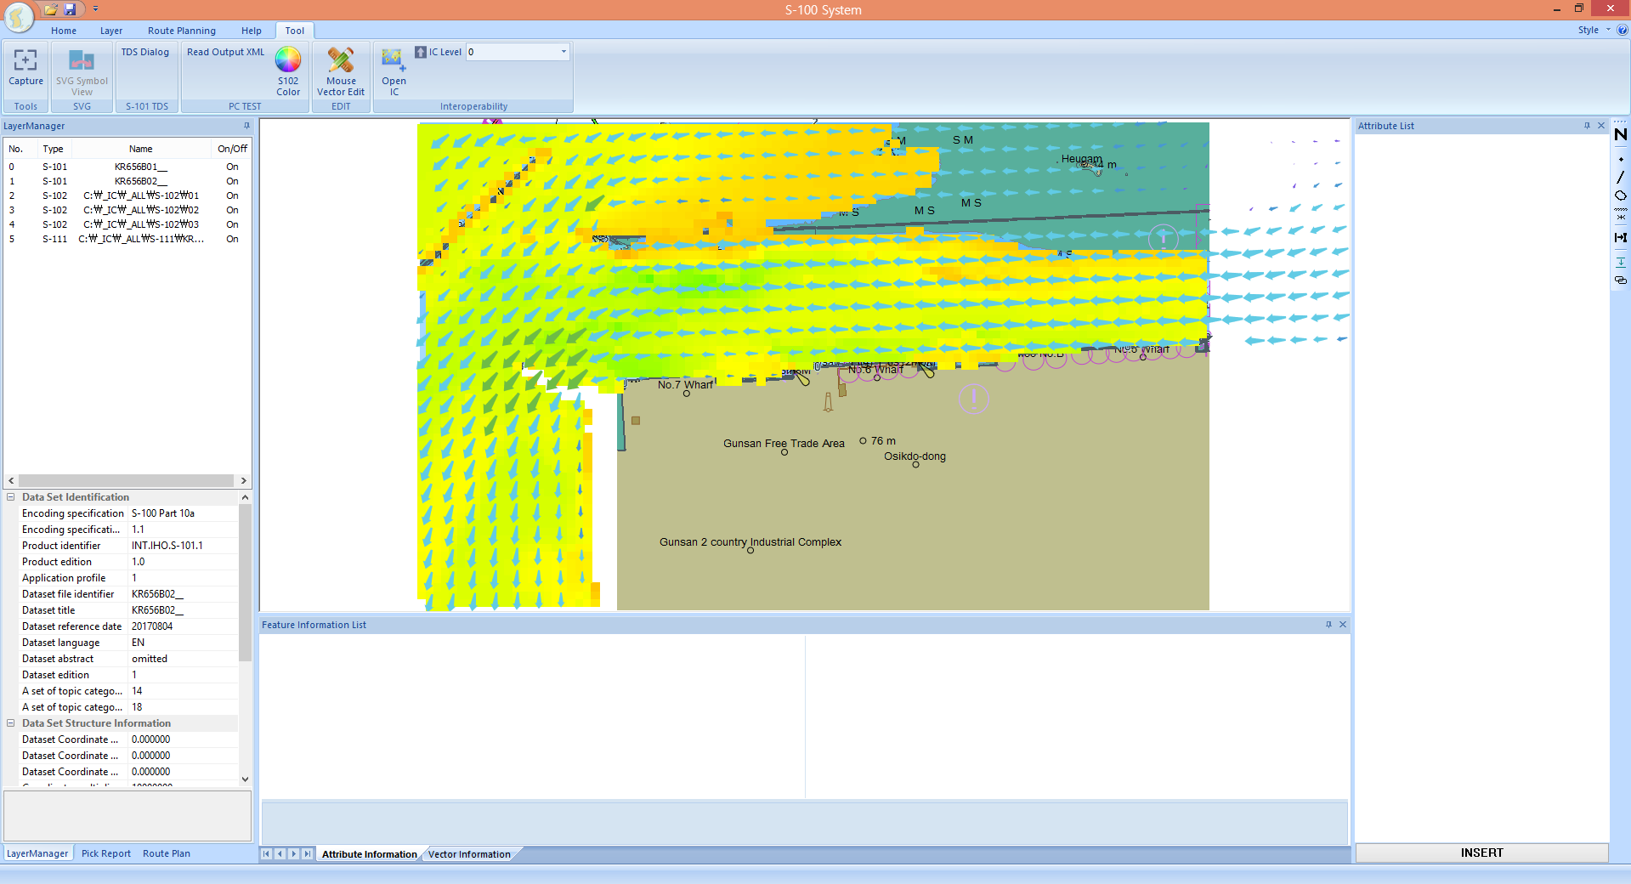
Better Interoperability
Rules Applied
Bathymetry no longer goes over the shoreline
Underlying ENC features are Visible
NO Rules Applied – ENC/Bathymetry/Surface Currents

Slide 6
Interoperability Levels
Level 1 – Data interleaving
Data is interleaved with each other based on display plane and drawing priority
Level 2 – Type based selectivity and feature class replacement
Allows for the suppression of all features of a specified feature type in a specified product
Level 3 – Feature hybridization (Currently out of scope)
Level 4 – Spatial Operations (Currently out of scope)

Slide 7
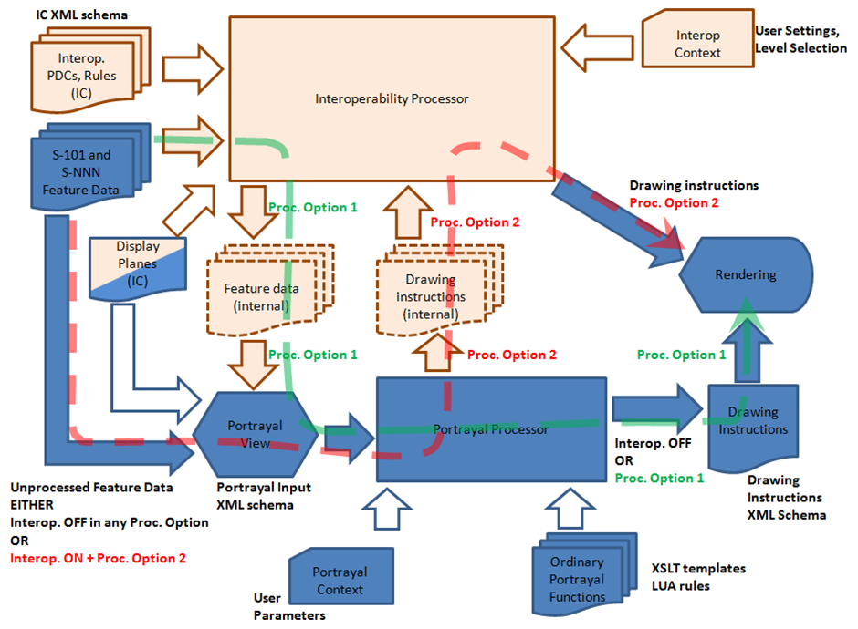
Basic Interoperability Processing

Slide 8
Path to publication of S-98 edition 1.0.0
December 2017 – S-98 sent to the S-100 stakeholder community for comments
Denmark
NIPWG
France
Sweden
USA – NGA
Majority of the comments are editorial in nature – some were substantive that need to be addressed

Slide 9
NIPWG Members Input
I would have liked to go into the review of this impressive document but when reading it I am looking first of all for the principles of the services (i.e. functionalities) than a S-100 ECDIS is intended to offer to the end-user by combining the ENC and other S-100 products.
As I understand the S-98, it is the specification of a technical framework for the technical implementation of concepts supporting functional principles. I also understand that another considerable work for IHO would be to populate the interoperability catalogue.
In the S-98, functional principles appear but they are mixed with the technical implementation specification. Thus, it is difficult to have a complete view of the functional principles, and so, to have a consolidated opinion on them, and on the subsequent technical concepts for their implementation.
Regards to the principles, we are uncomfortable with some aspects (if we understand correctly), for example with the assumption that some products are "superior” to the ENC. For us, it may depend on the end-user’s context and on his own decision to prefer the information from another product than ENC. It shouldn’t be reduced to single the choice of a level of interoperability.
I am wondering if a document describing the functional principles and other requirements exists. Such document should be the guidelines on which the IHO members and other stakeholders agree before the approval of the S-98. The work on the way of the technical implementation (S-98) is ongoing and seems well advanced for test-beds. S-98 will speed up developments. Thus, it seems important to elaborate guidelines to ensure that technical developments for operational solutions, including S-98, are aligned with what the IHO members want to offer to mariners within the framework of the e-navigation.

Slide 10
Path to publication - Recommendations
Q2 2018 -Incorporate the editorial changes into a revised draft
Q2 2018 -Create a red-line for any substantive comments
Q3 2018 Review redline at the S-100 Test Strategy Meeting
Address the need for a strong set of functional principles for S-98 as an executive summary of the document
Q3 2018 – Send S-98 for a second and final round of comments
Q4 2019 – S-100 finalizes S-98 for HSSC endorsement
Q2 2019 – HSSC Endorses S-98
Q3 2019 – S-98 Edition 1.0.0 is published

Slide 11
S-100WG is requested
Note the comments on S-98
Discuss the comments from NIPWG
Endorse the path to publication

